Slide 1


Slide 2
Chapter 8
Quantitative Methods

Slide 3
Introduction
Designing quantitative methods for a research proposal
Survey and experimental designs
Careful measurement, parsimonious variables, theory-guided

Slide 4
Defining Surveys and Experiments
Survey design
  Quantitative description of trends, attitudes, or opinions of a population
  Testing association
  Studying a sample of that population

Slide 5
Defining Surveys and Experiments
Experimental design
  Systematic manipulation of one or more variables to evaluate an outcome
  Holds other variables constant to isolate effects
  Generalize to a broader population

Slide 6
Components of a Survey Method Plan
The survey design
The population and sample
Instrumentation
Variables in the study
Data analysis and interpretation

Slide 7
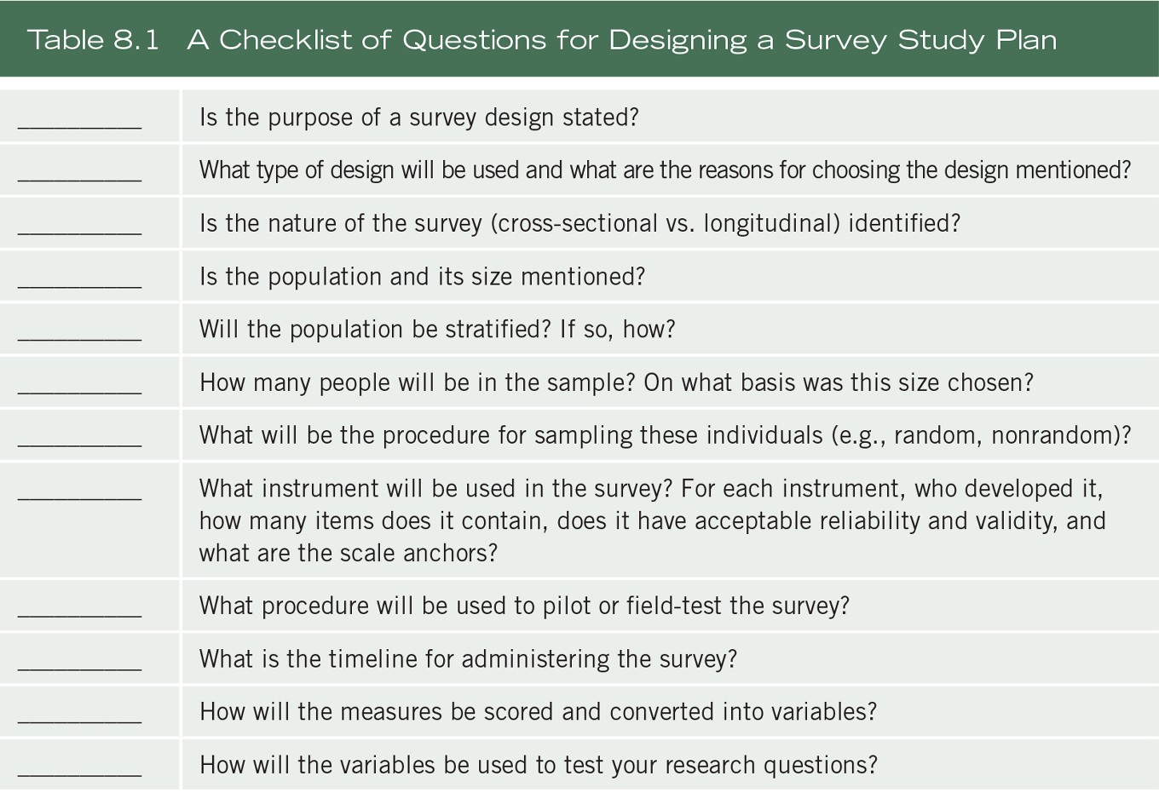
Components of a Survey Method Plan

Slide 8
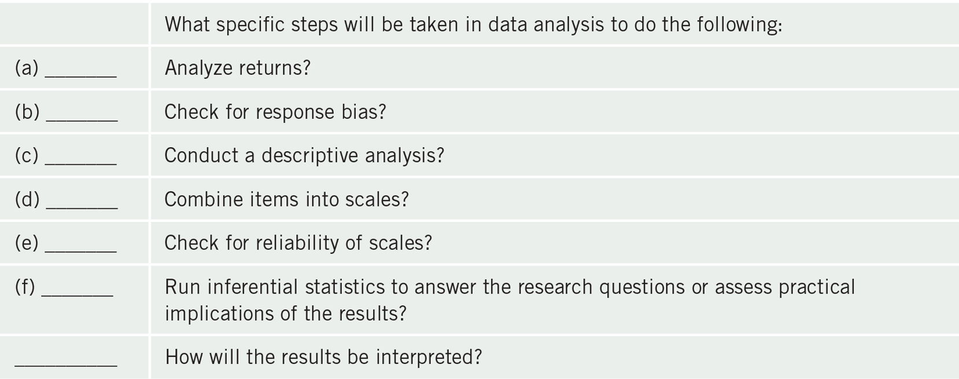
Components of a Survey Method Plan

Slide 9
Components of a Survey Method Plan
The survey design:
Provide a purpose for using survey research
Indicate why the survey method is preferred
Indicate the type of survey design
  Cross-sectional (data collected at one point in time)
  Longitudinal (data collected over time)
Specify the form of data collection – telephone, mail, Internet personal/group interviews) and rationale

Slide 10
Components of a Survey Method Plan
The population and sample:
Identify the population including size and sampling frames
Specify the sampling design
  Single-stage
  Multi-stage (clustering)
Type of sampling
  Probability
  Nonprobability

Slide 11
Components of a Survey Method Plan
The population and sample:
Indicate if the study involves stratification – ensuring specific population characteristics (e.g. gender) are represented
Indicate number in the sample and procedure to determine
Use a power analysis if you plan to detect significant associations

Slide 12
Components of a Survey Method Plan
The population and sample:
Power analysis involves
  Estimating the size of correlation
  An alpha value (type I error rate)
  A beta value (type II error rate)
  Conducting the power analysis (e.g., G*Power)
Conduct power analysis during planning

Slide 13
Components of a Survey Method Plan
Instrumentation:
Name the survey instrument used to collect data
Indicate how instrument was developed
Describe the established validity scores from past use
  Content validity
  Predictive or concurrent validity
  Construct validity
Describe reliability of scores from past use
  Internal consistency
  Test-retest

Slide 14
Components of a Survey Method Plan
Instrumentation:
When modifying or combining instruments, the original validity and reliability may not hold
Include sample items from the instrument
Indicate major content sections in the instrument
  Cover letter
  Items – demographics, attitude items, behavior items, factual items
  Closing instructions
  Type of scale for responses

Slide 15
Components of a Survey Method Plan
Instrumentation:
Discuss pilot testing or field-testing
  Rationale for plans
  Content validity and reliability
  Improve question
Steps for administering for a mailed survey

Slide 16
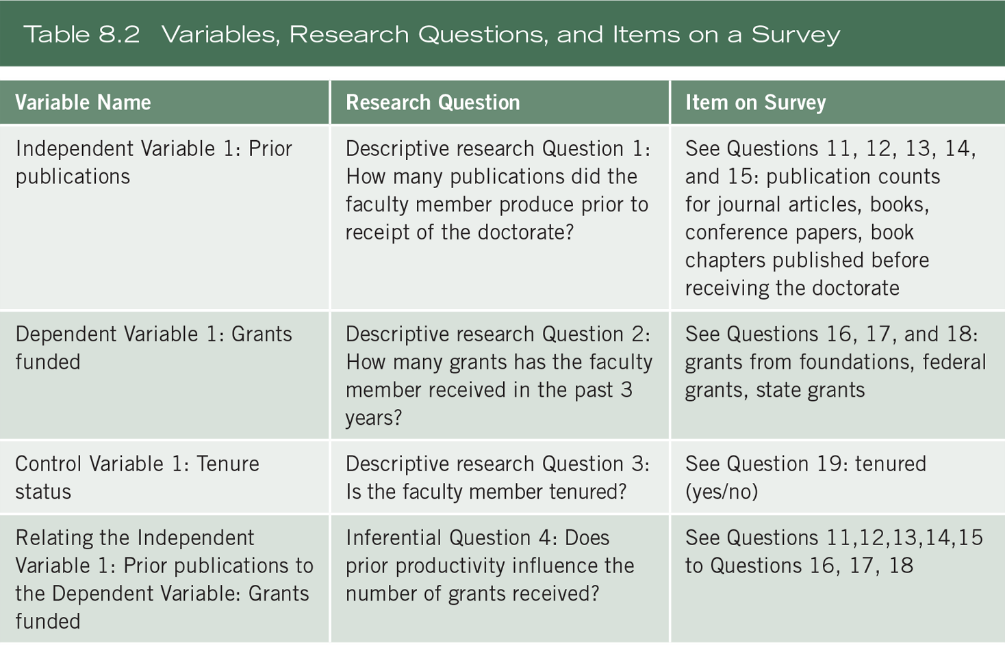
Components of a Survey Method Plan

Slide 17
Components of a Survey Method Plan
Data analysis:
Computer programs used for analysis
Data analysis steps
  Step 1. Number who did and did not respond
  Step 2. Method to determine response bias
  Step 3. Plan to provide descriptive analyses
  Step 4. Calculate total scale scores
  Step 5. Statistics and program for inferential statistical analyses
  Step 6. Present results in figures or tables and interpret

Slide 18
Components of a Survey Method Plan
Interpreting results and writing a discussion section:
Report how the results answered the research question or hypothesis
Practical evidence in terms of effect size and confidence interval
Discuss implications
  Consistent with, refute, extent previous studies

Slide 19
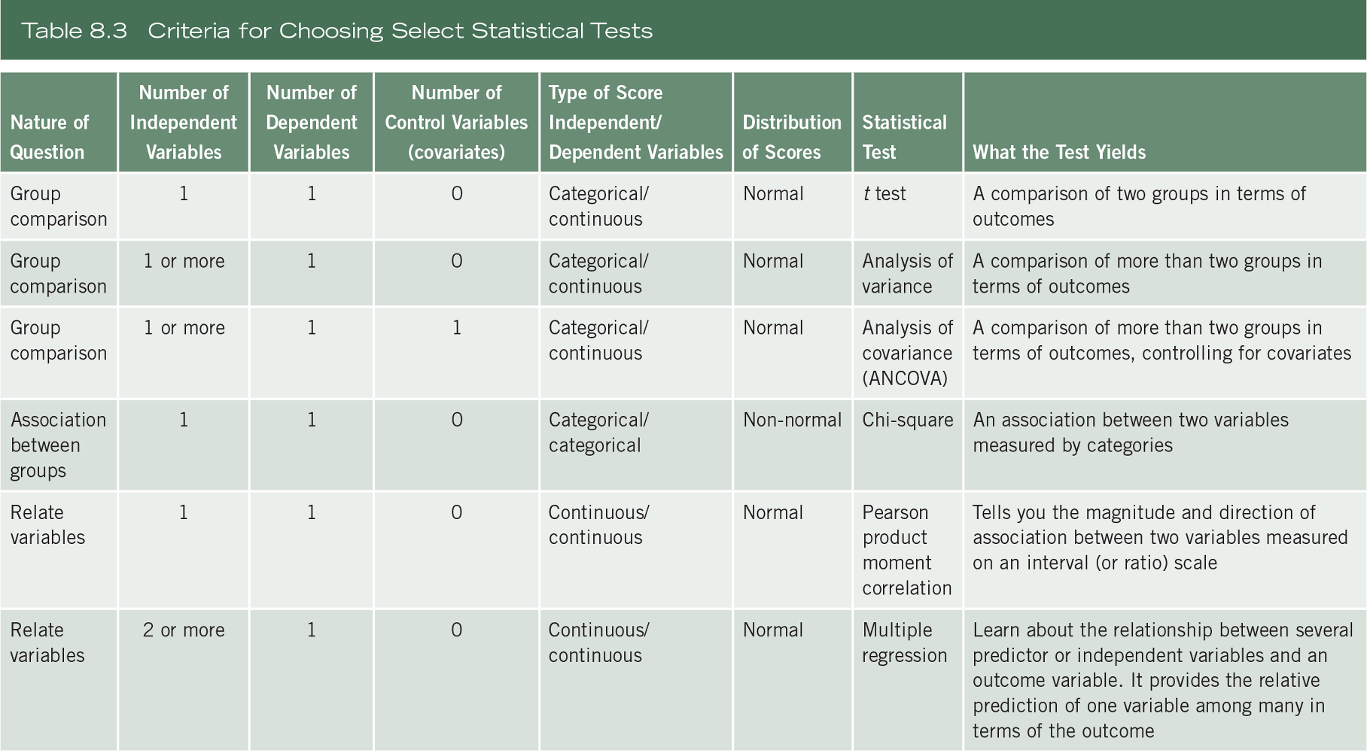
Components of a Survey Method Plan

Slide 20
Components of an Experimental Study Method Plan
Experimental method plan
  Participants
  Variables
  Instrumentation and materials
  Experimental procedures
  Threats to validity
  Data analysis
  Interpreting results and writing a discussion

Slide 21
Components of an Experimental Study Method Plan
Participants:
Describe procedures for recruiting participants
Describe the selection of participants as either
  Random
  Nonrandom (convenience)
True experiment – individuals randomly assigned to groups
Quasi-experiment – partial or no control over random assignment

Slide 22
Components of an Experimental Study Method Plan
Participants:
May measure second predictor variables
Conduct and report power analysis
End with formal experimental design statement
  “The experiment consisted of a one-way two-groups design comparing burnout symptoms between full-time and part-time nurses”

Slide 23
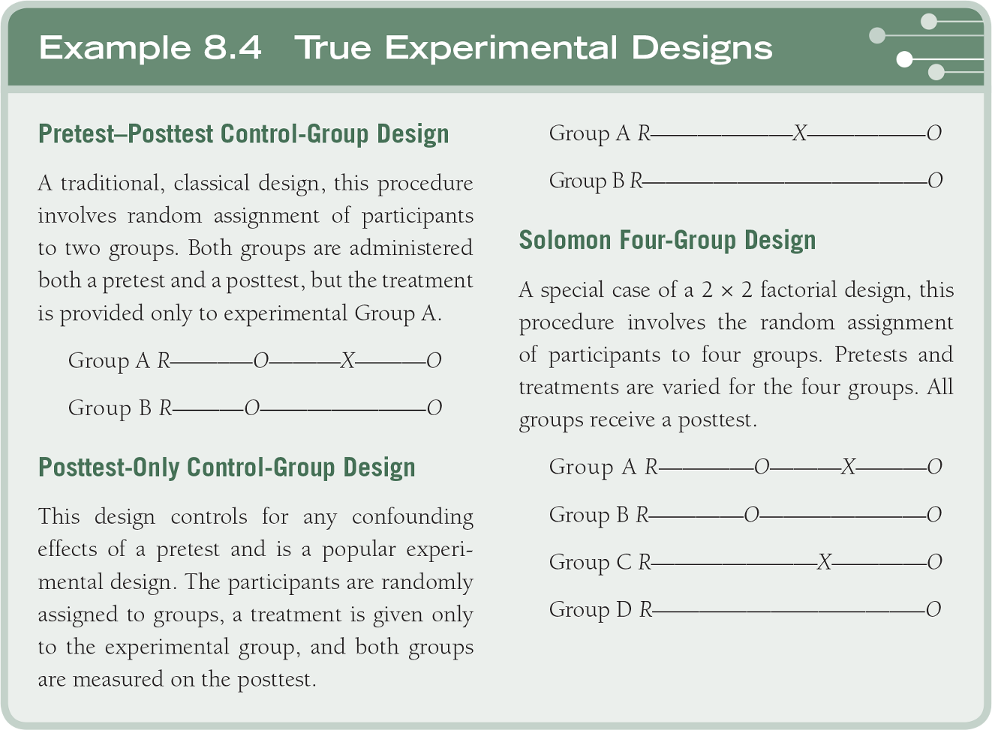
Components of an Experimental Study Method Plan

Slide 24
Components of an Experimental Study Method Plan
Variables:
Specify the variables and describe in detail
  Identify the independent variables
  Include a manipulation check measure
  Identify dependent variable
  Identify other variables measured
    Participant demographics
    Measure variables that contribute noise
    Potential confounding variables

Slide 25
Components of an Experimental Study Method Plan
Instrumentation and materials:
Describe the instrument(s) participants complete in the experiment
  Development, items, and scales
  Reliability and validity reports of past uses
Thoroughly discuss materials used for the treatment
Cover story to explain procedures if deception is used

Slide 26
Components of an Experimental Study Method Plan
Experimental procedures:
Identify the type of experiment
  Pre-experimental, true experiment, quasi-experiment, single subject design
Identify the type of comparisons – within-group or between-subject
  Provide a visual model to illustrate the research design used
    X = treatment
    O = observation
    R = random assignment
See Examples 8.2–8.5

Slide 27
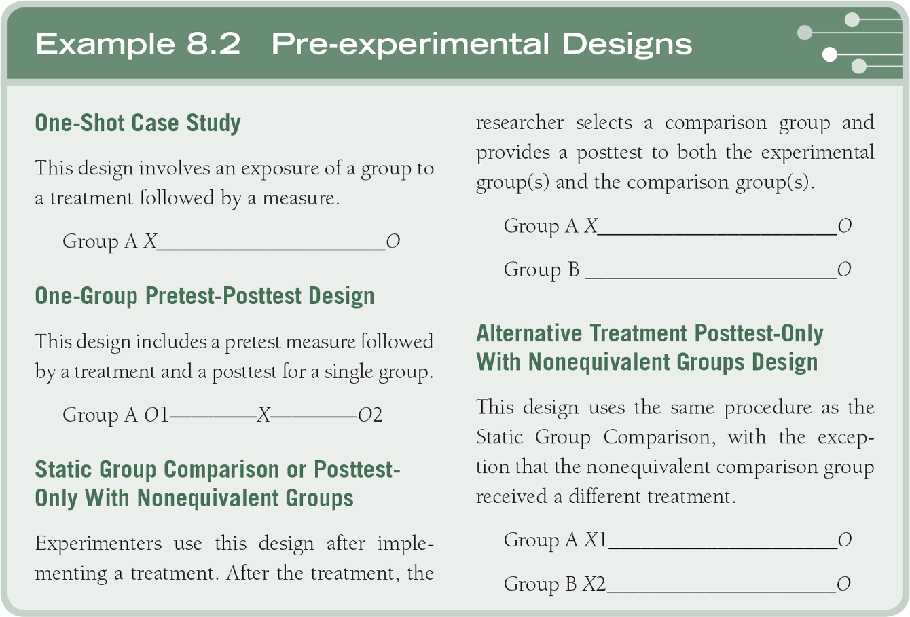
Components of an Experimental Study Method Plan

Slide 28
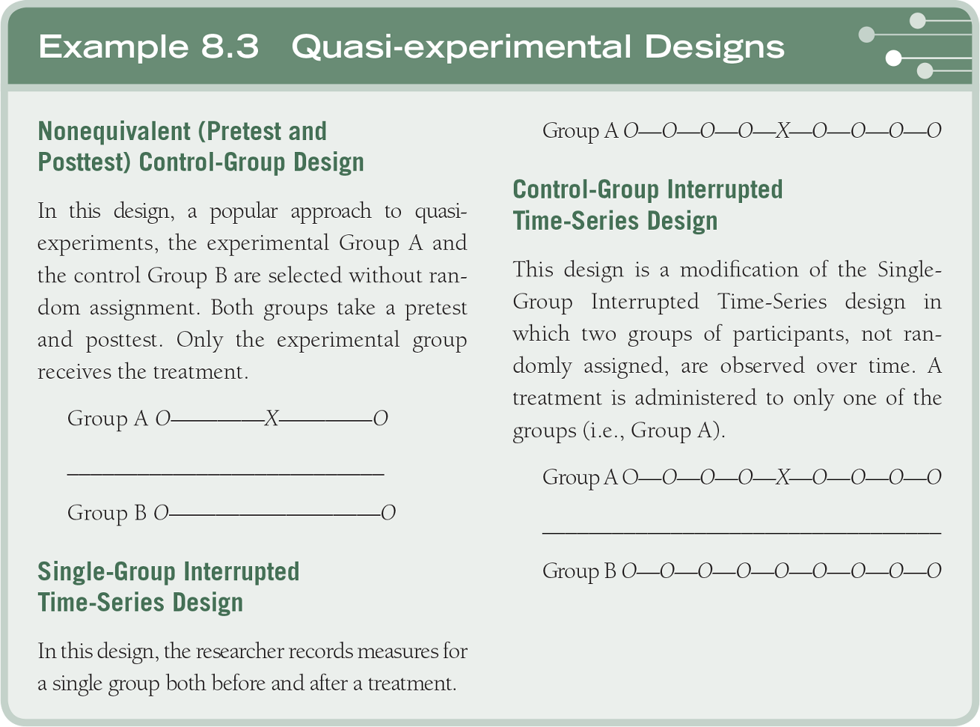
Components of an Experimental Study Method Plan

Slide 29
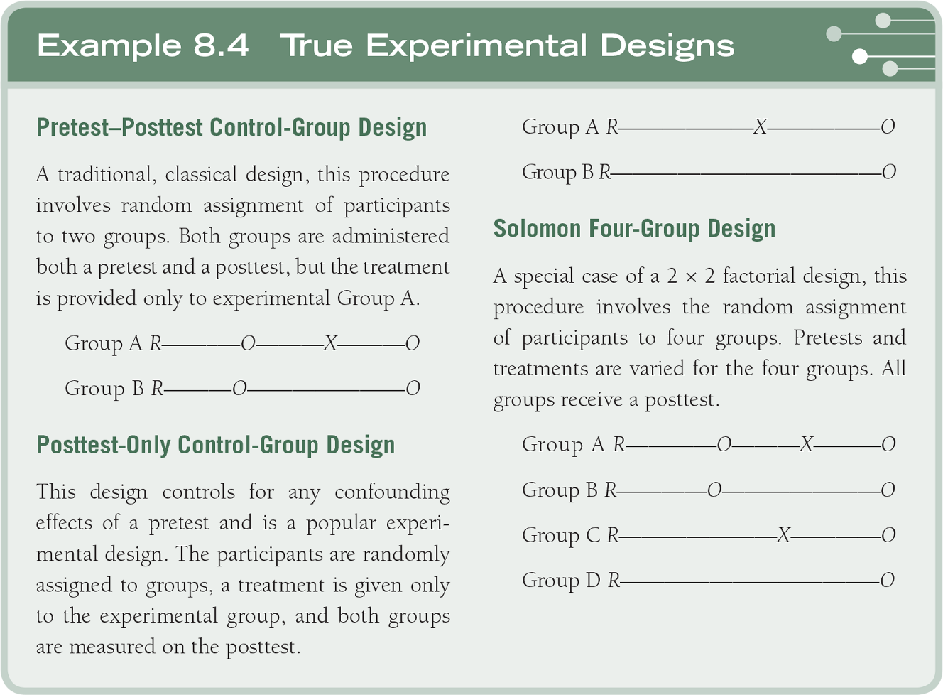
Components of an Experimental Study Method Plan

Slide 30
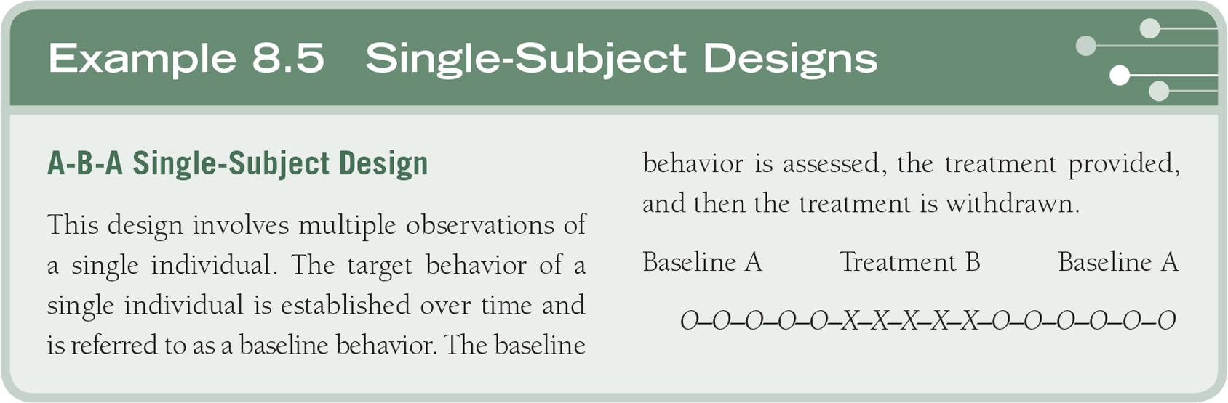
Components of an Experimental Study Method Plan

Slide 31
Components of an Experimental Study Method Plan
Threats to validity:
Internal validity – procedures, treatments, or experiences of the participants that threaten inferences in experiments
External validity – drawing incorrect inferences from sample data to other persons, settings, situations

Slide 32
Components of an Experimental Study Method Plan
Threats to validity:
Statistical conclusion validity – inadequate statistical power or violation of statistical assumptions
Construct validity – inadequate definitions and measures of variables

Slide 33
Components of an Experimental Study Method Plan
Threats to internal validity
  History
  Maturation
  Regression
  Selection
  Mortality
  Diffusion of treatment
  Compensatory/resentful demoralization
  Compensatory rivalry
  Testing
  Instrumentation

Slide 34
Components of an Experimental Study Method Plan
Threats to external validity
  Interaction of selection and treatment
  Interaction of setting and treatment
  Interaction of history and treatment

Slide 35
Components of an Experimental Study Method Plan
The procedure:
  Administer measures of the dependent variable or a variable closely correlated
  Assign participants to matched pairs
  Randomly assign one member of each pair to the control and experimental group
  Expose experimental group to the treatment
  Administer measures of dependent variables
  Compare performance of the experimental and control groups

Slide 36
Components of an Experimental Study Method Plan
Data analysis:
Report descriptive statistics (e.g., means, standard deviations, ranges)
Indicate inferential statistical tests (e.g., t test, ANOVA, ANCOVA, or MANOVA)
Report confidence intervals and effect sizes in addition to statistical tests
Use line graphs for single subject designs

Slide 37
Components of an Experimental Study Method Plan
Interpreting results and writing a discussion section:
Interpret findings in light of hypotheses and research questions
Whether supported or refuted
Why results significant or not, literature
Indicate implications
Suggest future research

Slide 38
Summary
The methodological approach to a survey or experiment
Surveys – purpose, population and sample, instruments, relationship, research questions, items, analysis
Experiments – identify participants, variables, instruments, type of experiment, validly, analysis

